Slide 1
E-COMMERCE
OLIST STORE ANALYSIS
BY:
Kiran.S
Kaviti Menaka
Konni Devi
Praneeth Kumar
Kamisetty Likhita Bhavani
Sree Vishnu S.P

Slide 2
INTRODUCTION
The presentation focuses on analyzing the Olist store, likely exploring its business performance, customer insights, and operational metrics. Olist, an online marketplace platform, is examined through aspects such as sales trends, customer feedback, product categories, and marketplace operations. The team's objective is to uncover actionable insights that can enhance business strategies and improve operational efficiency.
OBJECTIVES
To evaluate Olist store performance: Understanding its sales trends, customer behavior and market penetration.
To identify challenges: Highlighting areas of improvement in operations, customer satisfaction and revenue generation.
To provide actionable insights: Recommending strategies for growth, customer engagement and product optimization.

Slide 3
INSIGHT
Unique orders
99,441
Total payment Value
16.01M
Total Price
13.59M
Total Profits
2.42M

Slide 4

WEEKDAY VS WEEKEND (ORDER_PURCHASE_TIMESTAMP) PAYMENT STATISTICS
We loaded all the datasets into Excel and transformed the data using the Power Query Editor.
We cleaned the data, removed duplicates, replaced null values with 0, and eliminated unnecessary columns.
After completing the cleaning process, we established connections between the datasets and created a merged file.
Finally, we extracted Weekday vs. Weekend data from the order_purchase_timestamp column.
We used pivot tables to visualize the data through pivot charts.
WEEKDAY
WEEKEND

Slide 5
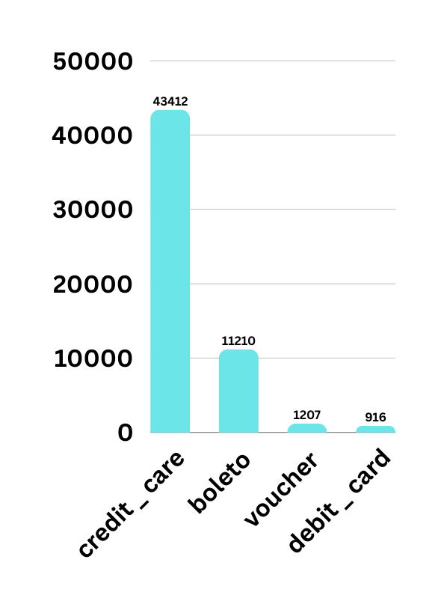

NUMBER OF ORDERS WITH REVIEW SCORE 5 AND PAYMENT TYPE AS CREDIT CARD.
We used the previously merged Excel file to create a Tableau chart.
We placed Payment Type in the Rows and Order ID in the Columns.
We added Review Score to the Filters and selected a range of values equal to 5.
We also added Payment Type to the Filters and filtered only for Credit Card payments.

Slide 6
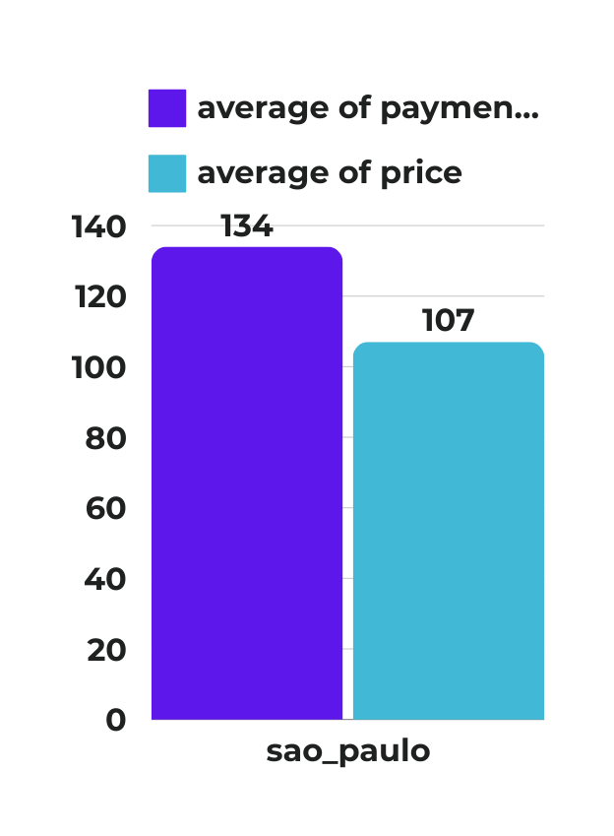
AVERAGE PRICE AND PAYMENT VALUES FROM CUSTOMERS OF SAO PAULO CITY
We loaded all the datasets into Power BI and used Power Query to clean the data.
We removed duplicates, replaced null values with 0, and eliminated unnecessary columns.
We performed data modeling and filtered the data for São Paulo city using customer city column.
Finally, we performed aggregations on Price and Payment Value, calculating their averages.

Slide 7
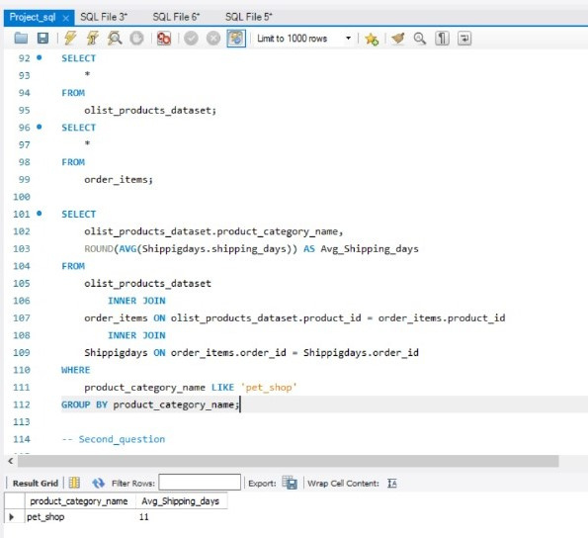
AVERAGE NUMBER OF DAYS TAKEN FOR ORDER_DELIVERED_CUSTOMER_DATE FOR PET_SHOP
We calculated Shipping Days by using the formula:
(order_delivered_customer_date - order_purchase_timestamp) and calculated the average.
We used an Inner Join to connect the order_dataset and product_dataset, applying the condition for PetShop

Slide 8
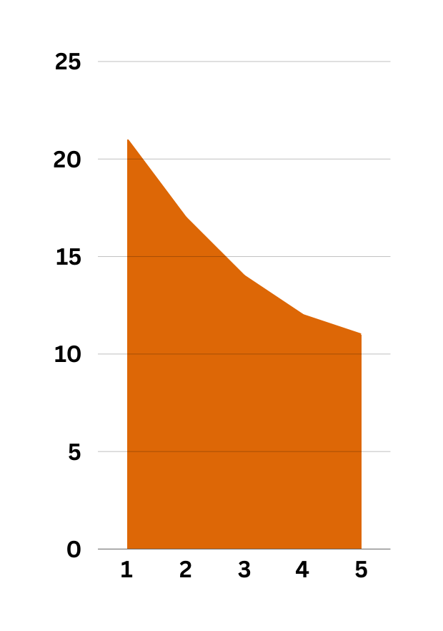
RELATIONSHIP BETWEEN SHIPPING DAYS (ORDER_DELIVERED_CUSTOMER_DATE - ORDER_PURCHASE_TIMESTAMP)
Vs review scores.
We placed Review Score in the Columns.
We placed Shipping Days in the Rows.
We selected the measure as Average.

Slide 9
SUMMARY
The analysis revealed that timely deliveries and credit card payments are linked to higher customer satisfaction, with São Paulo customers displaying distinct spending patterns. Category-specific insights, such as delivery metrics for "pet shop," further highlight operational performance trends.
ANALYSIS :-
INSIGHT :-
Timely deliveries and the use of credit cards significantly improve customer satisfaction, as reflected in higher review scores. São Paulo customers and specific categories like "pet shop" exhibit unique spending and delivery patterns.
Focus on delivering orders faster to improve customer satisfaction
Encourage customers to use credit cards by offering rewards, as they are linked to better reviews.
Develop targeted plans for cities like São Paulo based on their unique shopping habits.
NEXT STEP :-

Slide 10
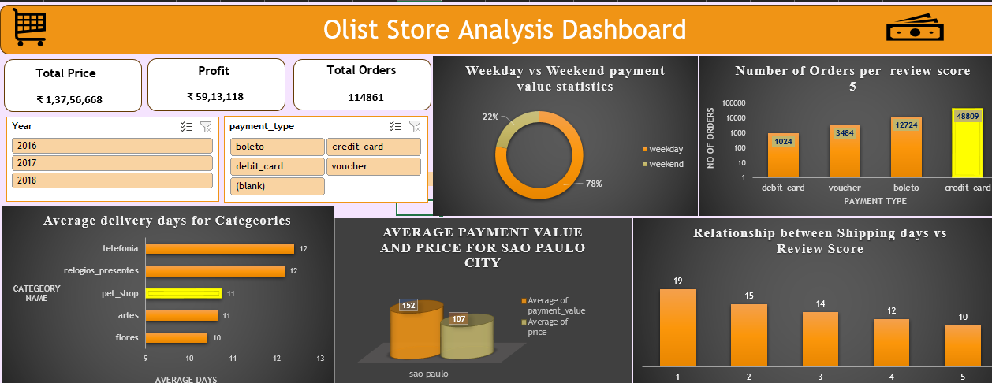

Slide 11
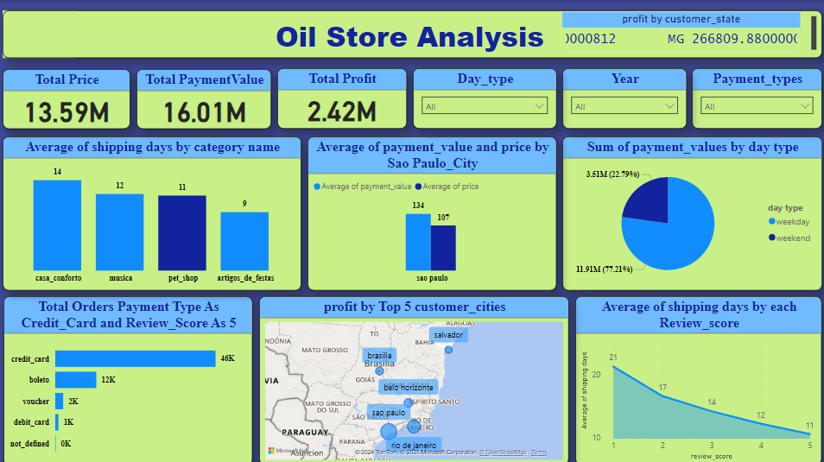

Slide 12
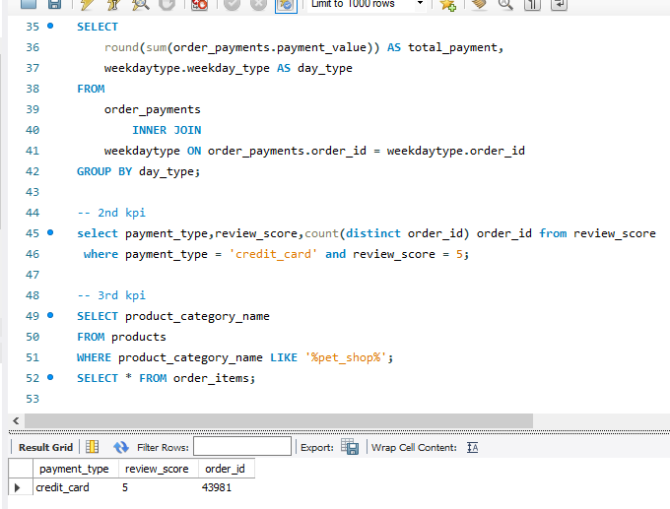

Slide 13
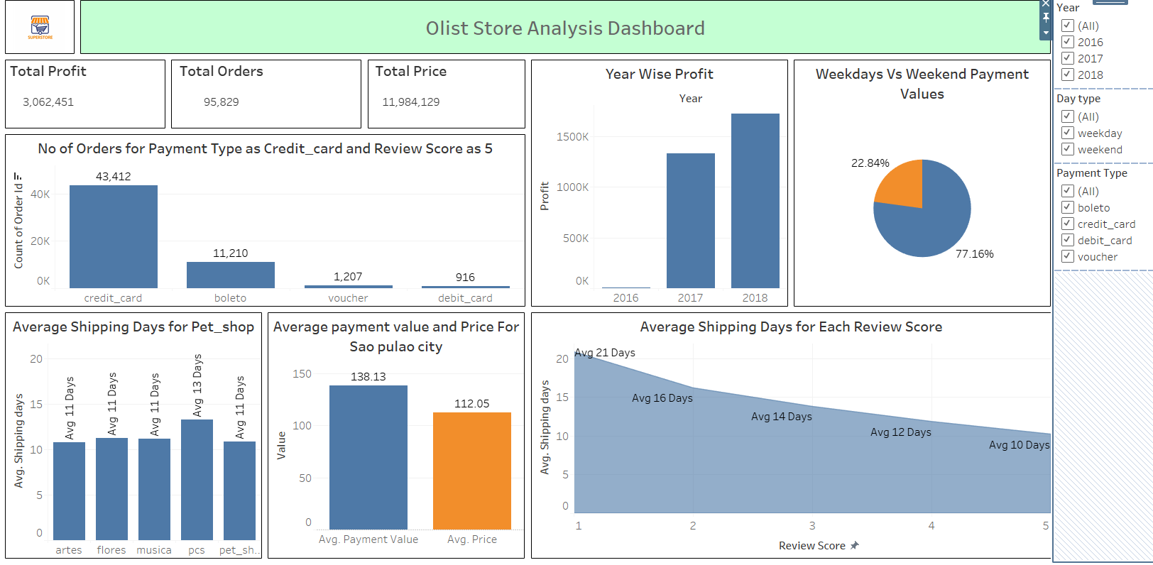

Slide 14
THANK YOU

